Slide 1
Measuring the Centralization of DNS Resolution
Geoff Huston, Joao Damas,
APNIC Labs

Slide 2
What are we talking about?
The DNS is a highly decentralised database that distributes its contents over much of the Internet
The DNS data model also includes information replication (secondary authoritative servers) that attempts to provide resiliency and scalability by removing critical single choke points within the database
The DNS name resolution protocol includes query fallback to increase the robustness of name resolution
It all sounds as if the DNS highly diverse and extensively decentralised.

Slide 3
What are we talking about?
The DNS is a highly decentralised database that distributes its contents over much of the Internet
The DNS data model also includes information replication (secondary authoritative servers) that attempts to provide resiliency ands scalability by removing critical single choke points within the database
The DNS name resolution protocol includes query fallback to increase the robustness of name centralisation
It all sounds as if the DNS highly diverse and extensively decentralised.
But is it really decentralised?

Slide 4
Measuring Centrality
Various measures have been used in the related space of market dominance which appear to have some relevance to the study of market dominance in the DNS
  Australia’s Consumer and Competition agency uses a metric of 70% market share by a single entity
  Or there is the four-firm concentration ratio which uses the market share of the four largest firms
  Or there is the Hirfindahl-Hirschman index

Slide 5
Herfindahl-Hirschman Index
The HHI is used in market analysis to indicate the level of competition between market entities. It is the average market share of the market, weighted by market share
Sum of the square of the market share (%) of the top 50 entities
Above 25% is often taken as an indicator of market skew
Above 10% is would be considered as a market showing “moderate concentration”

Slide 6
The DNS resolution environment
The question of centrality in the DNS resolution environment is equivalent to the questions of market dominance and market concentration
So lets look at DNS resolution as a market and use these measurements to assess the degree of concentration in the supply of DNS resolution services

Slide 7
Looking at concentration in DNS Name Resolution
I. How centralized is the recursive resolver function?
II. How centralized is the authoritative server function?
Stub-to-Recursive
Recursive-to-Authoritative
user
Recursive Resolver
Authoritative Server

Slide 8
I Recursive Resolution

Slide 9
Measuring Recursive Resolution
We use Ads to send each user a unique DNS name to resolve.
We use an authoritative server as the data collection point and collect the IP address of the resolvers asking the authoritative server
We then use the Ad presentation data to match this query to an end user IP address
user
Recursive Resolver
Authoritative Server
Measurement
Ad placement data
<ID, IPaddr>
DNS query data
<ID, DNS resolver IPaddr>

Slide 10
Tuning the measurement
The Authoritative Server always answers queries immediately with the A / AAAA records as requested
The data is unsigned and the responses fit comfortably within 512 octets of DNS payload
We try to minimise timeouts and requeries by steering users to a DNS Authoritative server that is (roughly) on the same continent as the user

Slide 11
Mapping
We need to map the resolver “helper” addresses to a resolver service
  Which back-end DNS addresses are used by each open resolver?
  RIPE Atlas helped here for those cases where the open resolver operator does not publish this information
We map resolvers into a number of categories based on the resolver’s IP address. The categories we use:
  Resolver is in the same AS as the end user
  It’s a known Open DNS resolver
  Resolver is geo-located to the same CC as the end user
  Resolver is geo-located to a different CC from the end user

Slide 12
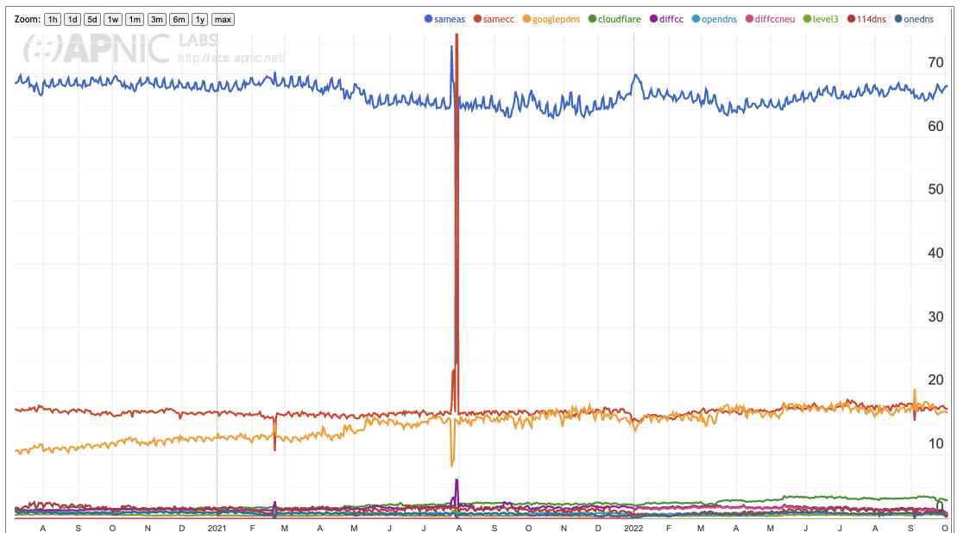
Results
Same AS
Google
Same CC
Cloudflare
Others
June 2020
October 2022

Slide 13
Results
Two-thirds of users direct their queries to the recursive resolver that is operated by their ISP
One seventh (15%) of users have their queries resolved by Google’s Public DNS resolver
One seventh (15%) of users direct their queries to a recursive resolver that is geolocated to the same country as they are – probably their ISP using a resolver in a different AS
Everything else – nothing more than 3%
Is the recursive resolver market centralized? Probably not
Is the open recursive resolver market centralized? That’s a different question!
But first let’s understand what is being measured here

Slide 14
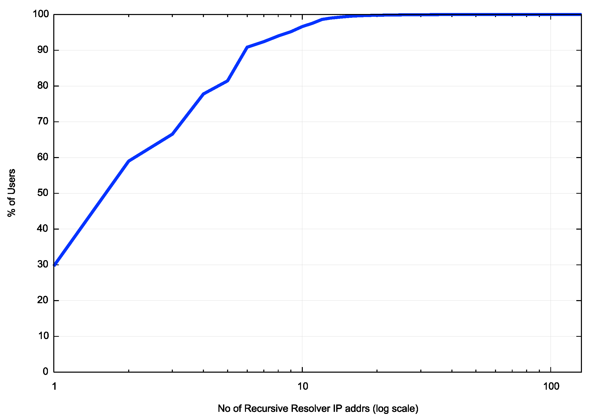
However, the measurement is not as simple as it may suggest
Cumulative Distribution of number of resolver IP addresses seen to query for a unique DNS name
We observe that this single initial query generates 1 or more queries from a single recursive resolver IP address just 30% of the time
2 or more different resolvers are queried in 60% of cases
Most of the time (90% of cases) these multiple resolver IP addresses are all in the same AS

Slide 15
Multiple resolvers “see” individual stub queries
We see an average of 3.23 distinct resolver IP addresses at the authoritative server for each queried domain name within the first 15 seconds
What should we do with these “extra” DNS queries?
In this case we just add them to the count
So we are measuring who “sees” my DNS queries

Slide 16
What are we measuring here?
So we thought that maybe we really wanted to know all the resolvers who might see your query
But to flush out all of these resolvers we need to adjust this experiment

Slide 17
Seeing Everything!
Get the authoritative server to return SERVFAIL all the time
This way the stub resolver is likely to cycle through all the locally configured recursive resolvers to find a non-SERVFAIL DNS response

Slide 18
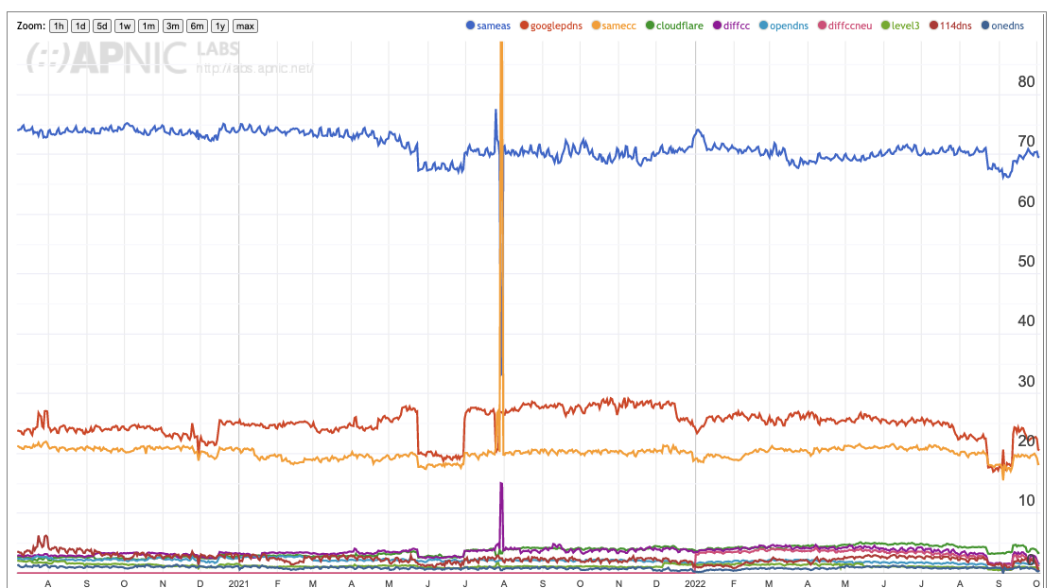
All Recursive Resolvers
Two-thirds of users direct their queries to the recursive resolver that is operated by their ISP
One seventh (15%) of users have their queries resolved by Google’s Public DNS resolver
One seventh (15%) of users direct their queries to a recursive resolver that is geolocated to the same country as they are – probably their ISP using a resolver in a different AS
Everything else – nothing more than 4%
fifth (20%)
sixth (16%)
3%

Slide 19
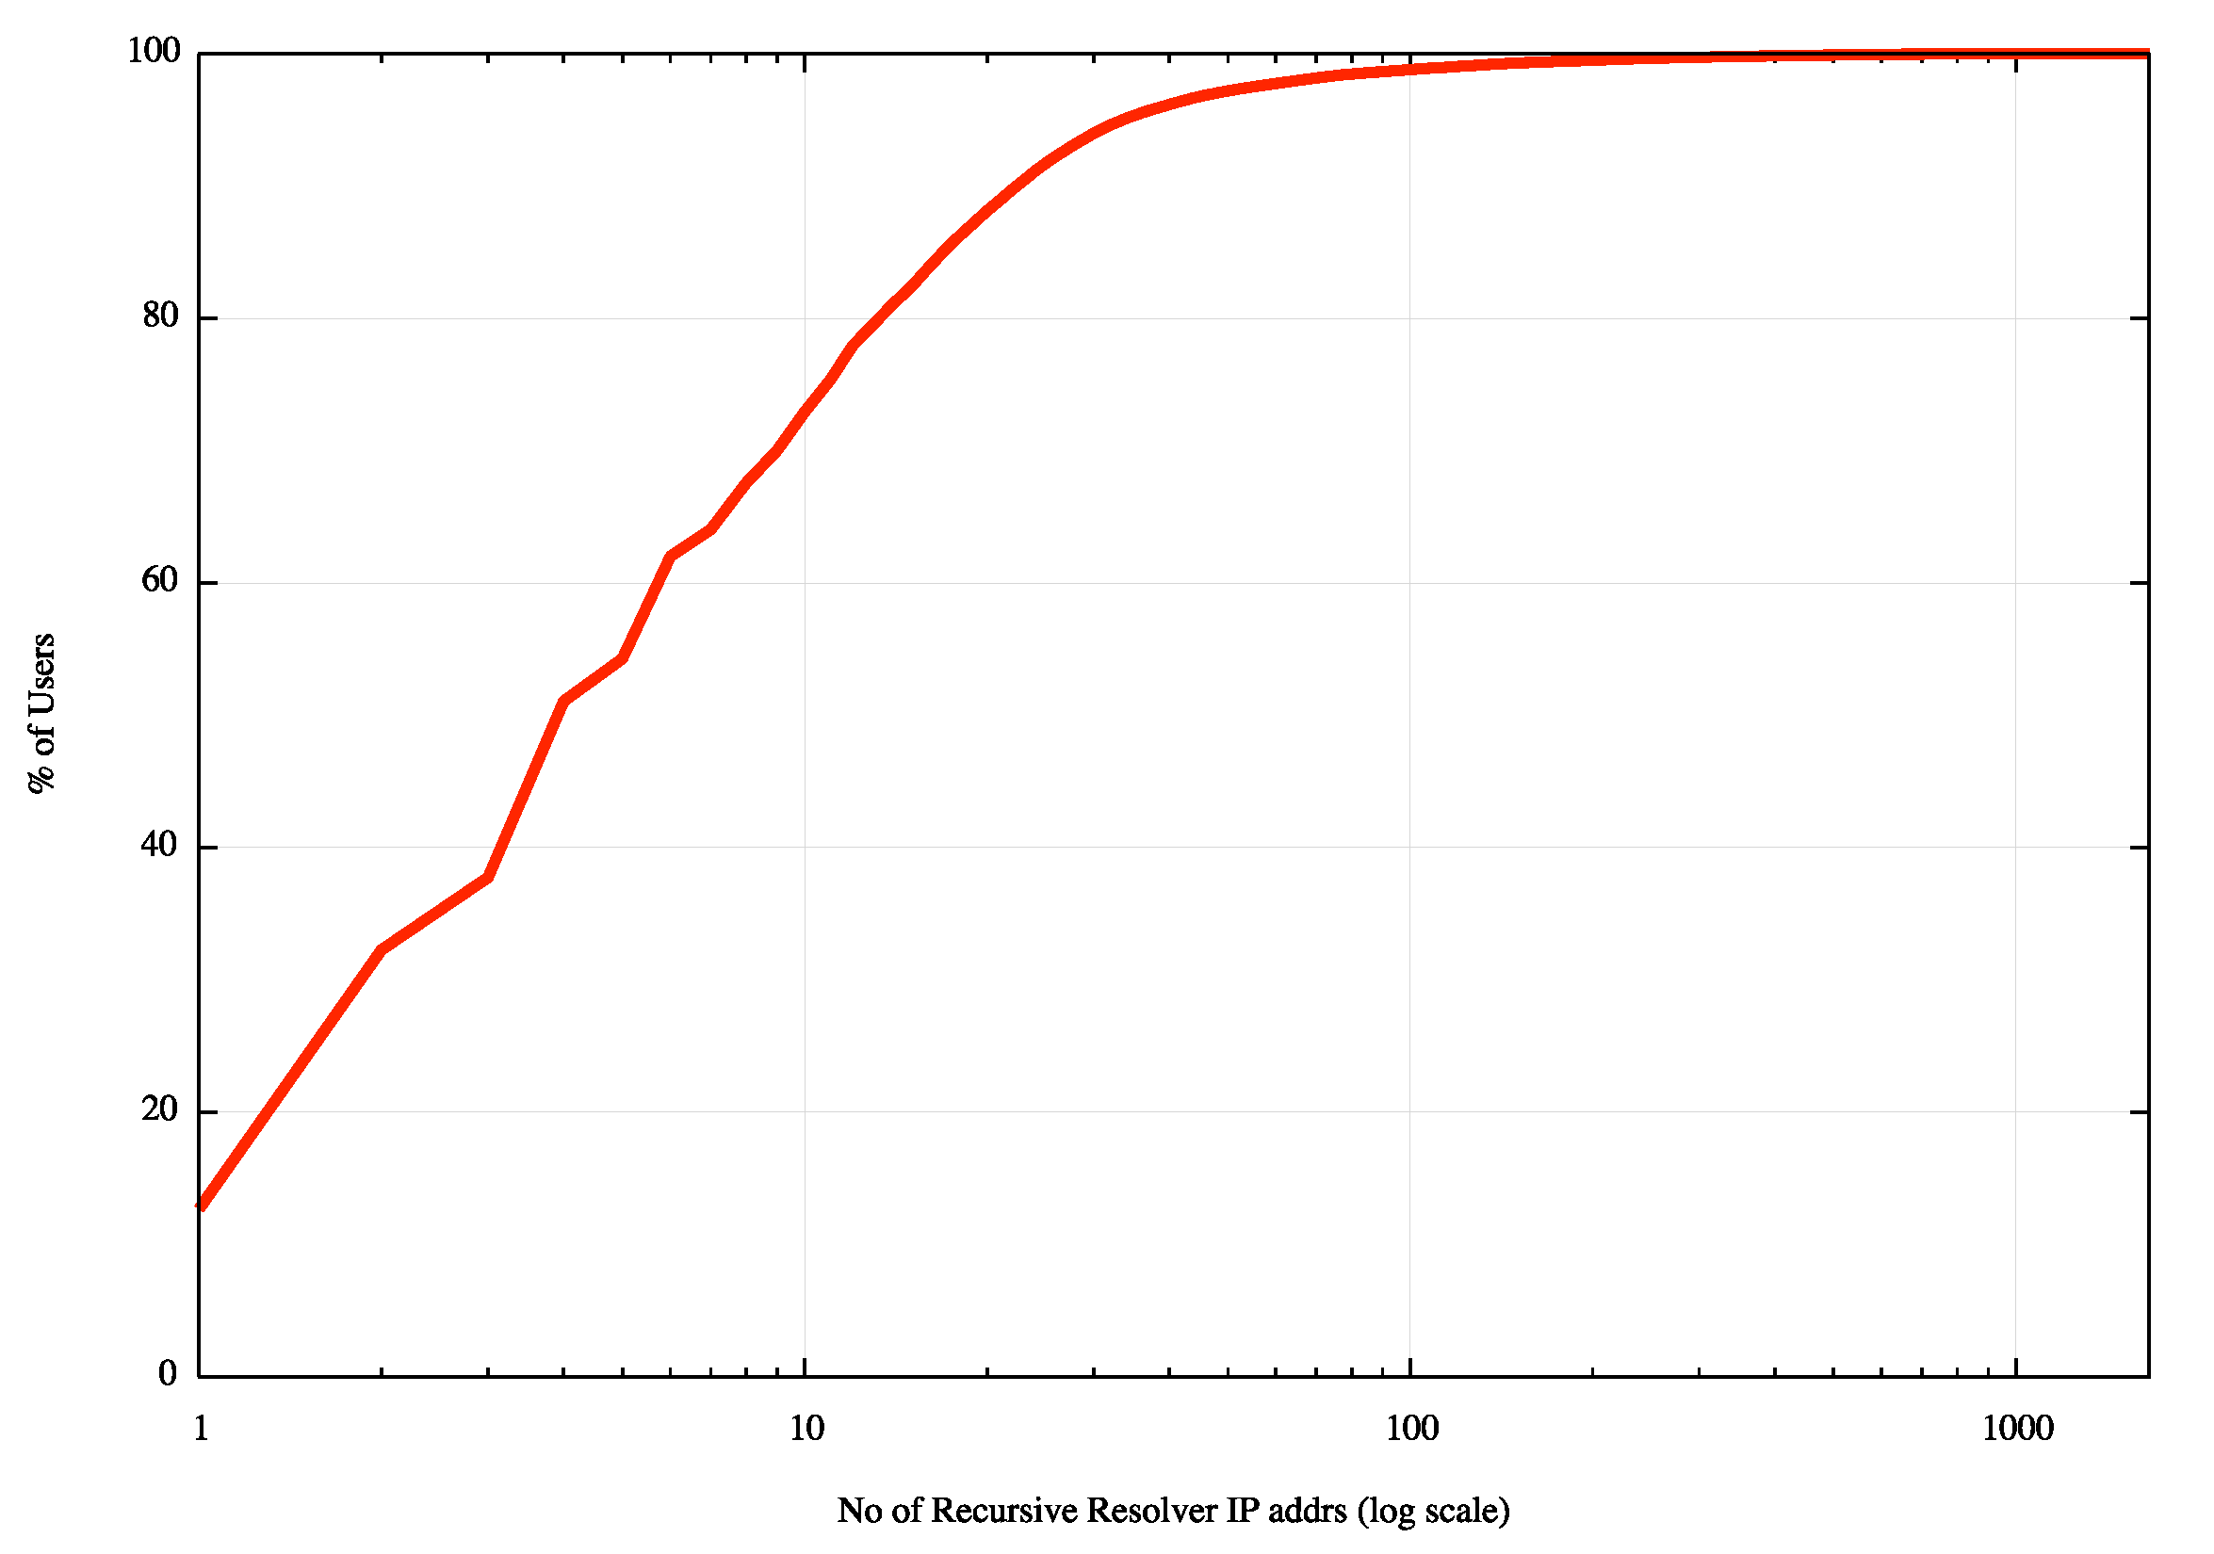
How many resolvers see the query now?
Cumulative Distribution of number of resolver IP addresses seen to query for a unique DNS name
when the response is SERVFAIL
We observe that this single initial query generates 1 or more queries from a single recursive resolver IP address just 12% of the time
2 or more different resolvers are queried in 30% of cases
Most of the time (75% of cases) these multiple resolver IP addresses are all in the same AS

Slide 20
Are we there yet?
No, not really
Perhaps it is also useful to understand which resolver provides the response that the user will use

Slide 21
Third Pass
Single query – same as Pass 1
But only record the first query at the auth server for each unique ID
  We assume that the first recursive resolver to ask the auth server is the first to provide a response to the stub resolver
How does this change the measurements?

Slide 22
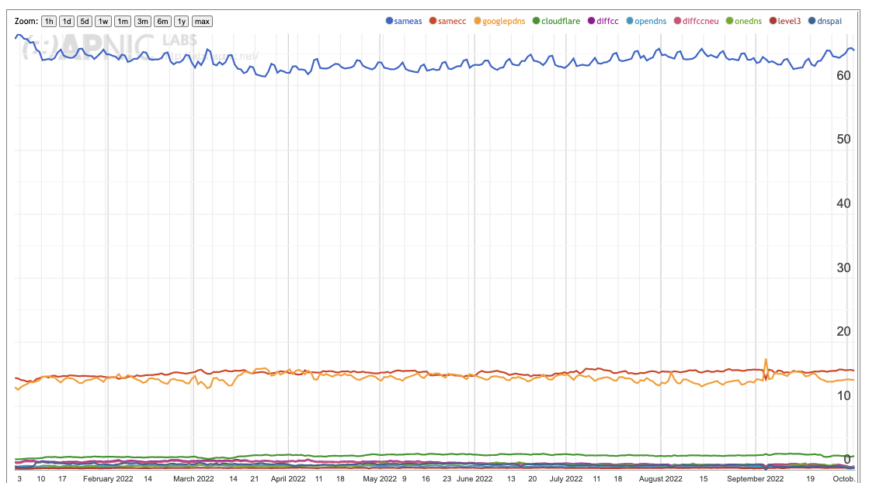
First Query Results
Two-thirds of users direct their queries to the recursive resolver that is operated by their ISP
One fifth (20%) of users have their queries resolved by Google’s Public DNS resolver
One sixth (18%) of users direct their queries to a recursive resolver that is geolocated to the same country as they are – probably their ISP using a resolver in a different AS
Everything else – nothing more than 4%
seventh (15%)
eighth (1%)
2%

Slide 23
What are we looking at?
Who gets to see my queries?
Who might get to see my queries?
Who do I believe for answers?

Slide 24
Concentration Measurements
Lets look at the “market” of DNS open resolvers using the “all resolvers” measurements
  Single Entity Dominance:
    Google has 68.7% of the open DNS resolver market
  Four-Firm Concentration:
    Google, Cloudflare, 114DNS and OpenDNS have 91.6% market share
  HHI Index:
    49%
So the open resolver market sector is highly centralized.
But this open resolver activity represents only one third of the total resolution market, and the HHI Index of the open resolvers as a subset of the total resolution market is far lower, at 5%

Slide 25
II Authoritative Servers
Data about the recursive-to-authoritative query set is hard to find
  Recursive resolvers sit in a privileged position in the DNS as they are exposed to both the identity of the stub resolver (the ‘user’) and the DNS names that they are querying
  So there are many caveats that apply to access to such data – and rightly so
At APNIC we have limited access to the data relating to the use of the 1.1.1.1 recursive resolver
  We don’t know who is querying, but we can see query names and query protocol
  The market share of Cloudflare’s open resolver service is around 3% of users which is a non-trivial resolver in the open resolver set (ranked #2 in terms of market share)

Slide 26
Centrality in Authoritative Servers?
One way to measure this is to look at the query-count weighted ranking of the DNS authoritative server providers
If an authoritative name server hosts a very popular domain name then it’s likely that the query count will be high
If a service operator hosts a large number of domains on its authoritative server infrastructure, then it’s likely that the query count will be high
So lets characterise the authoritative service hosting market by their query-based ‘market share’

Slide 27
What’s a “query”?
We use incoming queries to determine relative weight
user
Recursive Resolver
Authoritative Server
Cache
Incoming Query
Outgoing Query
The query count at this point depends on stub activity rather than cache settings
The query count at this point is dependant on the cache settings

Slide 28
Measurement Technique
Obtain a data set of 24 hours of query name data from the 1.1.1.1 resolver system
Group the query names
Resolve the names to find the “lowest” authoritative name server for the query name using a local resolution environment
Take the first name server name
Discard the query names
Resolve the name server names to IP address, and discard the name server names
Map the IP addresses to AS numbers, and discard the IP addresses
Group the query counts into AS numbers and rank by query share

Slide 29
Data Set
Rank | AS Number | Query Share | Cumulative Share | Name
56 | 31034 | 0.06% | 89.64% | Aruba, IT
57 | 20446 | 0.06% | 89.70% | Stackpath CDN, US
58 | 199524 | 0.06% | 89.76% | Gcore, LU
59 | 60068 | 0.05% | 89.82% | CDN77, GB
Here’s an extract of the resultant data set
The 24 hour data capture identified 26,971 unique AS numbers (out of a total of 75,000 unique AS numbers in the routing table)
While approximately one third of networks host at least one queried authoritative name server the top 50 ASNs have 89.2% of the query share.

Slide 30
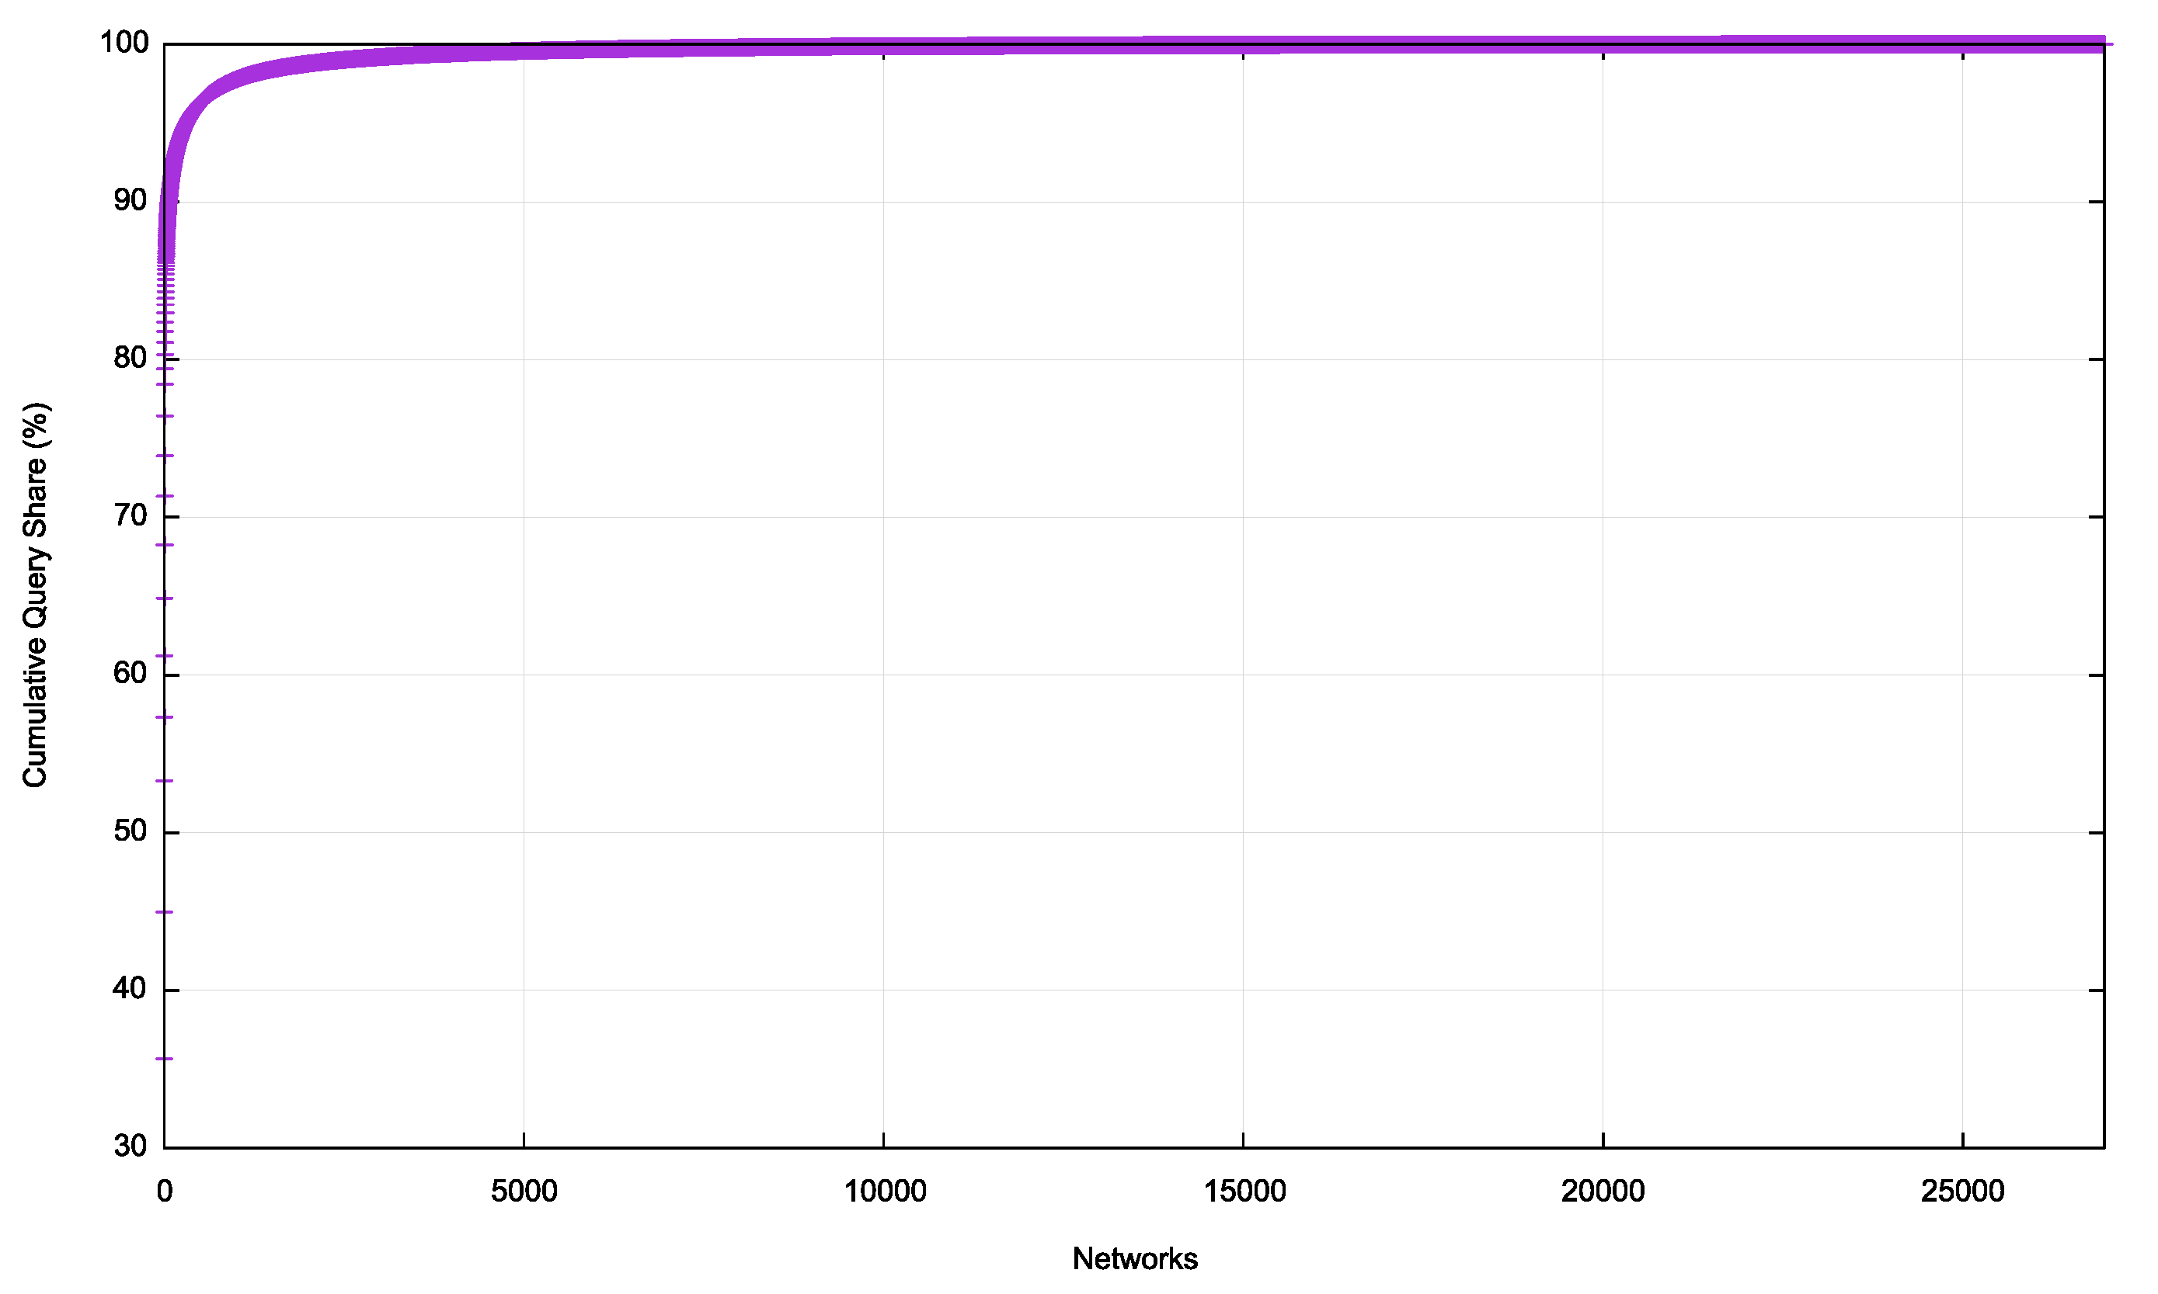
Cumulative Distribution

Slide 31
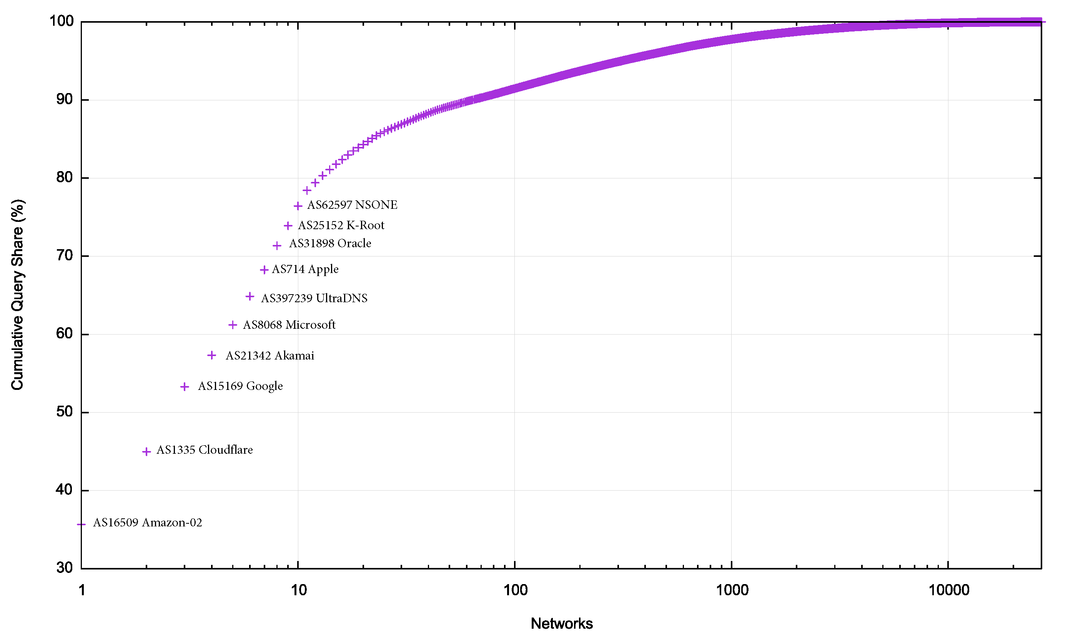
Cumulative Distribution

Slide 32
Top 10 Auth Server Networks
Rank | AS Number | Query Share | Cumulative Share | Name
1 | AS16509 | 35.7% | 35.7% | Amazon-02, US
2 | AS13335 | 9.3% | 45.0% | Cloudflare, US
3 | AS15169 | 8.3% | 53.3% | Google, US
4 | AS21342 | 4.0% | 57.3% | Akamai – ASN2, US
5 | AS8068 | 3.9% | 61.2% | Microsoft, US
6 | AS397239 | 3.7% | 64.9% | UltraDNS, US
7 | AS714 | 3.4% | 68.3% | Apple, US
8 | AS31898 | 3.1% | 71.4% | Oracle, US
9 | AS* | 2.5% | 73.9% | Root Server System
10 | AS62597 | 2.5% | 76.4% | NSONE, US

Slide 33
Concentration Measurements
Lets look at the “market” of DNS authoritative server providers using query-weighted ranking
  Single Entity Dominance:
    Amazon has 35.7% of the Authoritative Server market
  Four-Firm Concentration:
    Amazon, Cloudflare, Google, and Akamai have 57.3% market share
  HHI Index:
    15%
This appears to be a “moderately concentrated” market

Slide 34
Side note
What’s that root query volume?
  The root servers report that around 2/3 of the queries seen at the root result in NXDOMAIN responses
    (Duane Wessels, DNS OARC?? 20??)
  But this data indicates that only 2.5% of queries seen by this recursive resolver are NXDOMAIN queries
  Why?

Slide 35
Geopolitical Centrality?
There are 10 network entities who host the authoritative name servers that have a query share of three quarters of the recursive-to-authoritative DNS query volume
All 10 networks are attributed to US entities

Slide 36
Caveats
This analysis is based on a single 24 hour data set from a single open recursive resolver service
The query sample set is not completely uniform and there is a potential bias to enterprise use and some browser use
Using query volumes as a proxy for some form of market share is not a universally accepted analytic metric

Slide 37
Thanks!

